Slide 1

Predicting Heart Disease Risk Using Key Health Features: A Machine Learning Approach
Group 1
Fnu Arshika Farzeen
Nitin Varma Gokaraju
Revathi Surisetty
Shreya Podipireddy
Sravani Pendyala

Slide 2
Table of Contents
Introduction
Data Description
Data Attributes
Feature Importance and Execution Time: read.csv
Feature Importance and Execution Time: fread
Feature Importance and Execution Time: read.csv (After profiling)
Feature Importance and Execution Time: fread (After profiling)
Data Tab and Flame Graph
Random Forest Tree
Random Forest Tree using Dask
Time Plot Comparison with and without Dask

Slide 3
Table of Contents
Genetic Algorithm
Research Question for Grouping and Aggregation
Grouping and Aggregation with Pandas
Grouping and Aggregation with Dask
Time Plot Comparison: Pandas Vs Dask
Pandas Visualization
Dask Visualization
Conclusion
References
Contributions

Slide 4

Introduction
Heart disease is a leading cause of global mortality, contributing to millions of fatalities each year. It significantly impacts global health, making prevention and early intervention critical in reducing its burden.
Hypertension, obesity, smoking and age are major risk factors for heart disease, collectively worsening cardiovascular health by increasing blood pressure, inflammation, arterial damage, and the risk of life-threatening events like heart attacks and strokes.
Understanding the relationship between these risk factors, and heart disease is essential for improving prevention strategies and early intervention efforts.

Slide 5
Data Description
The data has been collected from the Kaggle.
https://www.kaggle.com/datasets/priyamchoksi/100000-diabetes-clinical-dataset
The dataset contains comprehensive health and demographic information of 100,000 individuals, including factors like age, gender, race, BMI, blood glucose levels, and diabetes status. This dataset supports various analytical use cases, such as predictive modeling, health analytics, demographic studies, and public health research, allowing for the exploration of diabetes risk factors and the identification of comorbidities like hypertension and heart disease.

Slide 6
Data Attributes
Year
Gender
Age
Location
Race: African American
Race: Asian
Race: Caucasian
Race: Hispanic
Race: Other
Hypertension
Heart disease
Smoking history
BMI
HbA1c_level
Blood glucose level
Diabetes

Slide 7
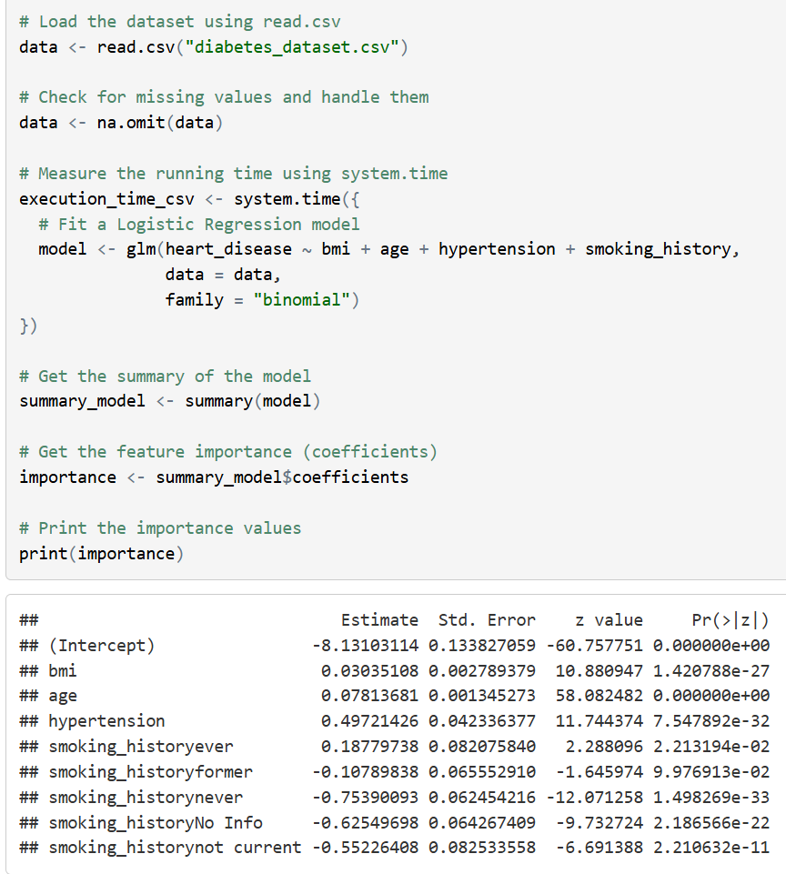
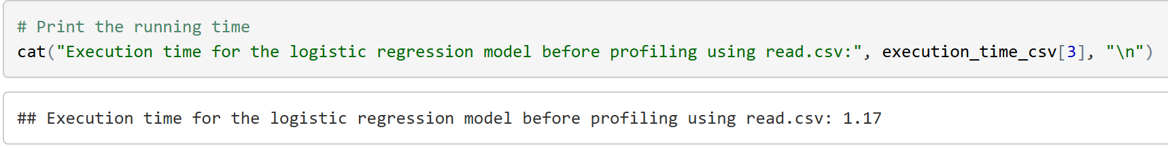
Feature Importance & Execution Time: read.csv
Interpretation: The p-values for all the features are below 0.0001 suggesting that these are significant predictors of heart disease.
The execution time for logistic regression model using read.csv function before profiling was 1.17 seconds.

Slide 8
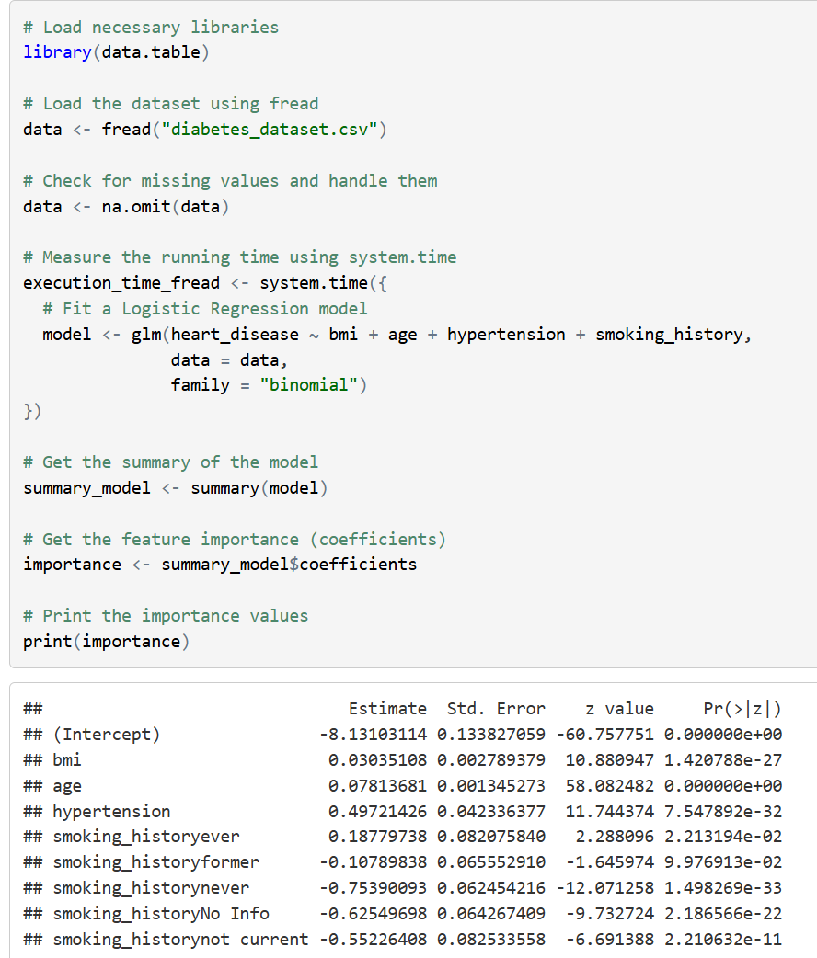
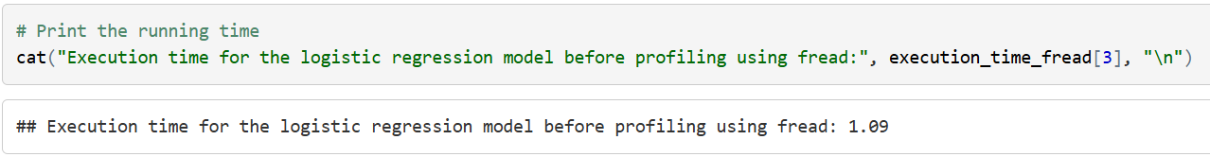
Feature Importance & Execution Time: fread
Interpretation: The p-values remain same for both the methods (read.csv and fread) i.e., below 0.0001 showing the features are significant to predict heart disease.
The time taken for execution of logistic regression model using fread function before profiling was 1.09 seconds, indicating a faster performance of using fread.

Slide 9
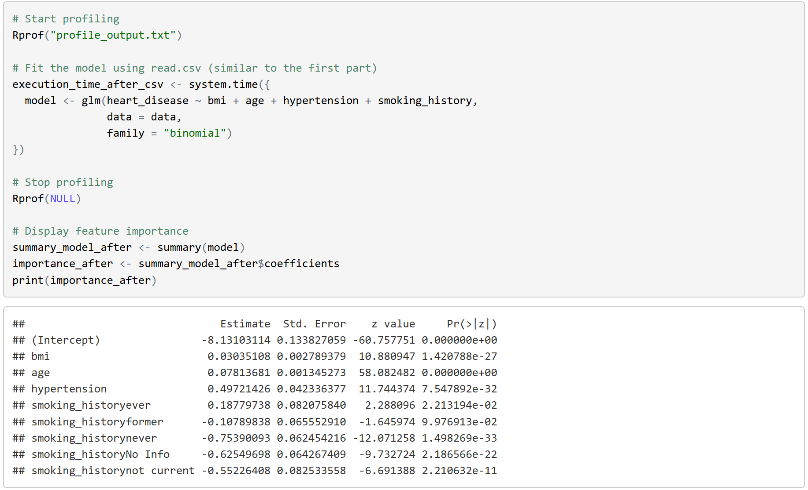
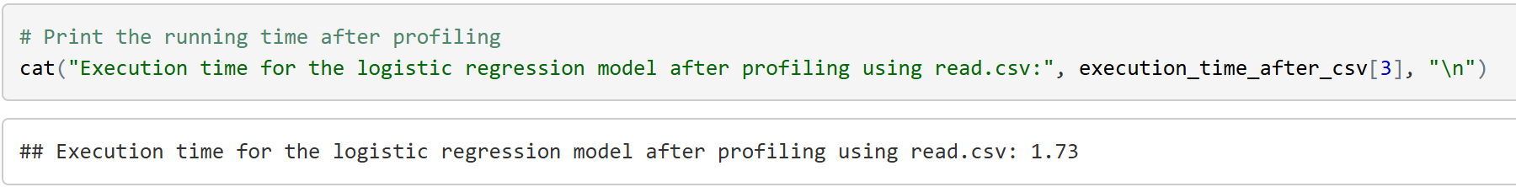
Feature Importance & Execution Time: read.csv (After Profiling)
Interpretation: The p-values remain constant after profiling.
The time taken for logistic regression model execution by using read.csv function after profiling was 1.73 seconds.

Slide 10
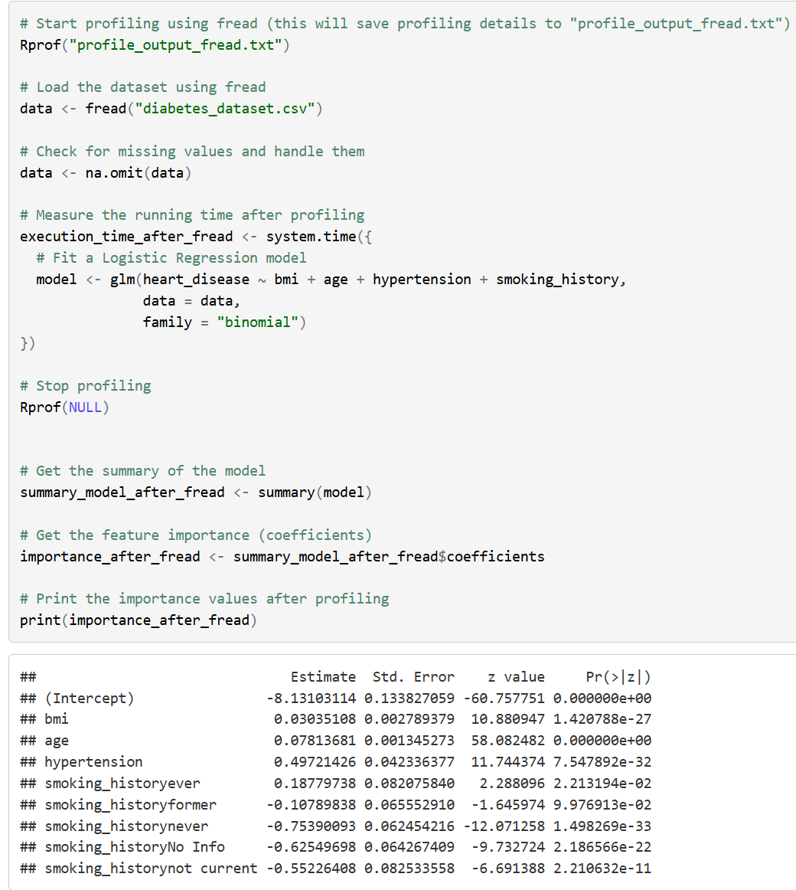
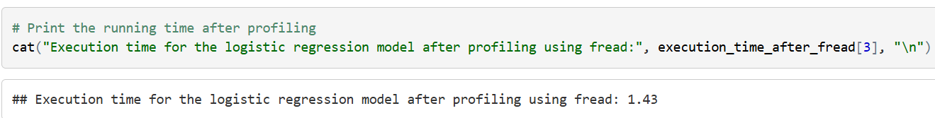
Feature Importance & Execution Time: fread (After Profiling)
Interpretation: The p-values remain constant after profiling.
The time taken for logistic regression model execution by using fread function after profiling was 1.43 seconds.

Slide 11
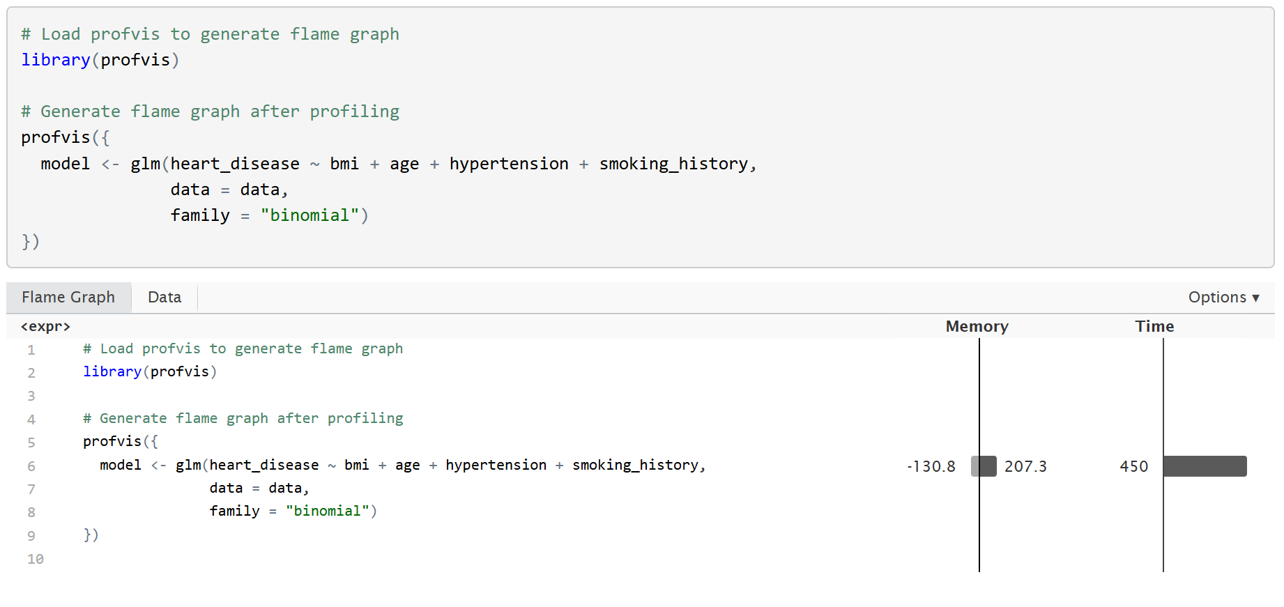
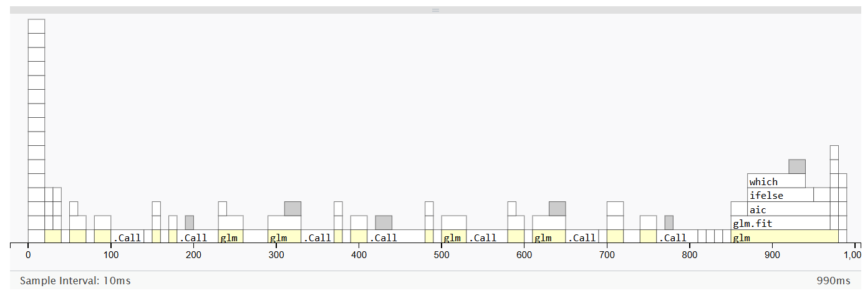
Data Tab and Flame Graph

Slide 12
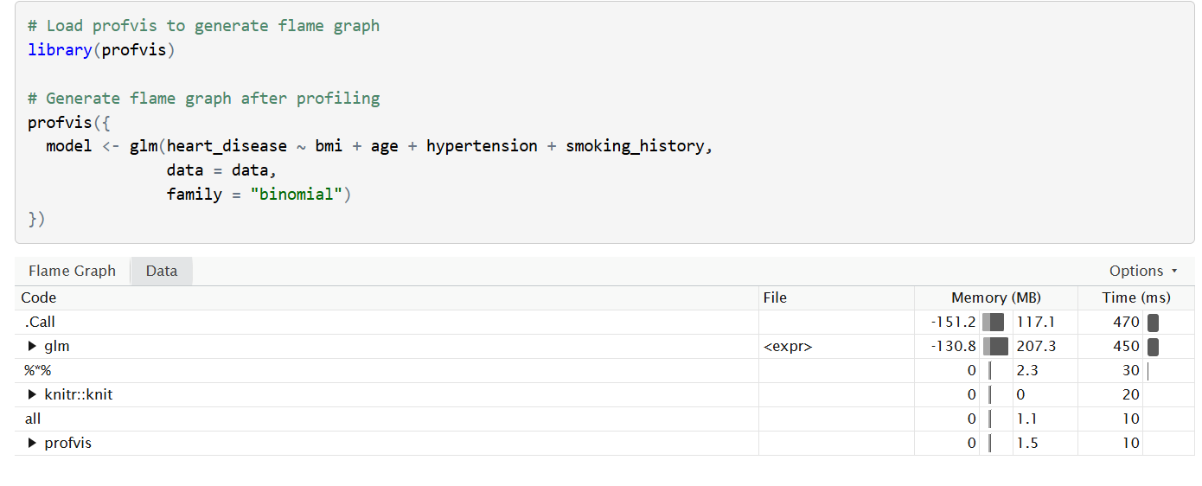
Data Tab and Flame Graph
Interpretation: In terms of execution time, the method using fread before profiling 1.09 seconds was faster than the method using read.csv before profiling 1.17 seconds. Similarly, after profiling, the performance was same, where fread showed faster performance with an execution time of 1.43 seconds and the read.csv took 1.73 seconds. Overall, the fread remained as a faster option when compared to read.csv method.

Slide 13
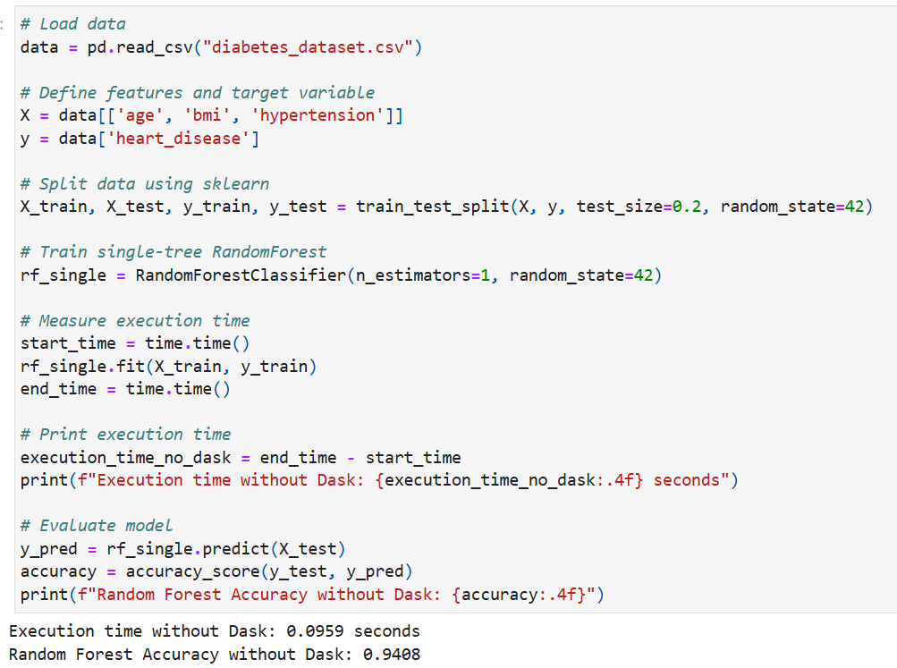
Random Forest Tree
Interpretation: The accuracy of the model before parallelization was about 94%, and the time taken to execute the process was 0.0959 seconds.
Notes:
S

Slide 14
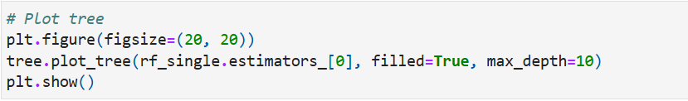
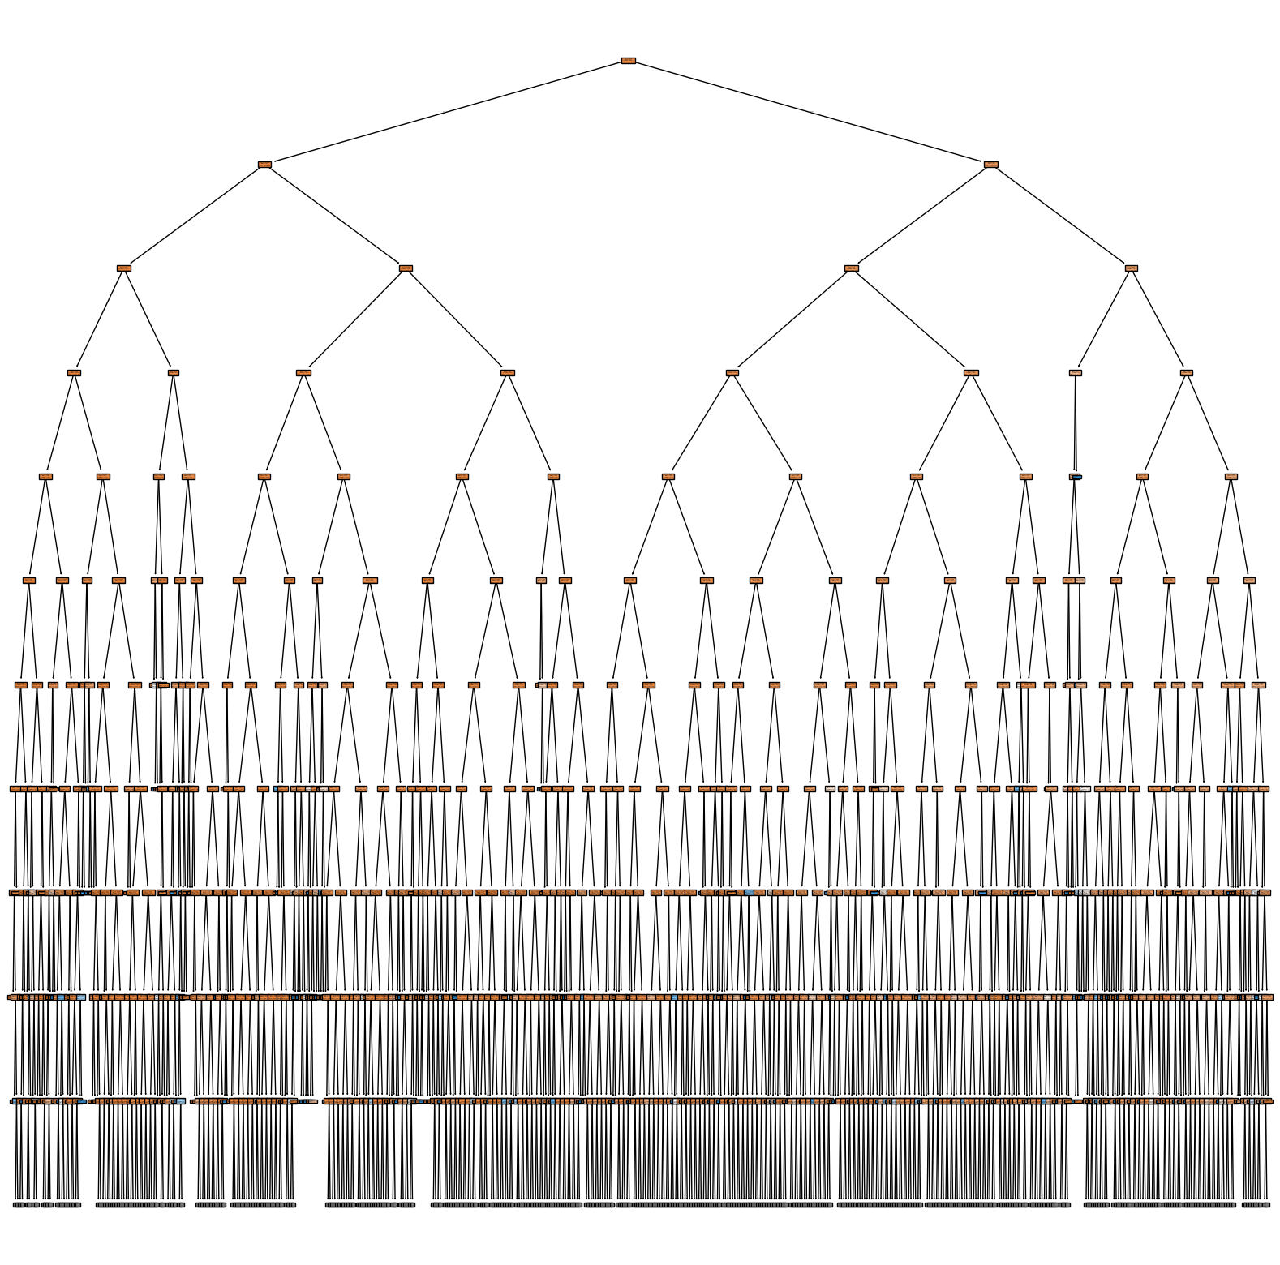
The random forest tree before parallelization was plotted.

Slide 15
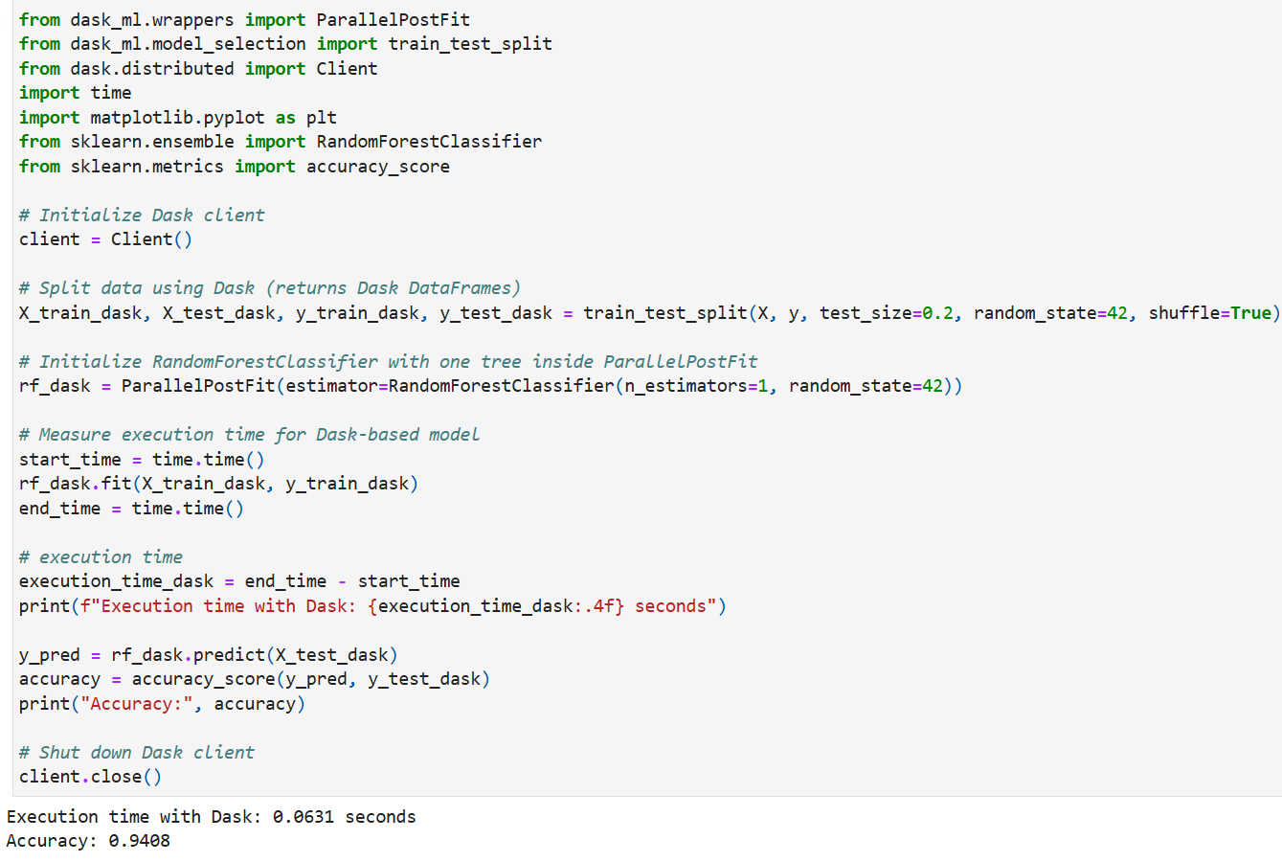
Random Forest Tree with Dask
Interpretation: The model accuracy after parallelization using dask remained same (about 94%), however the execution time was significantly lower, about 0.0631 seconds, indicating a faster performance using dask.

Slide 16
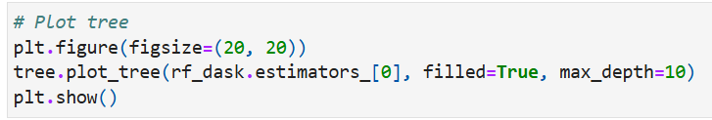
The random forest tree after parallelization using dask was plotted.

Slide 17
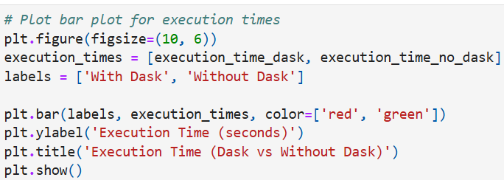
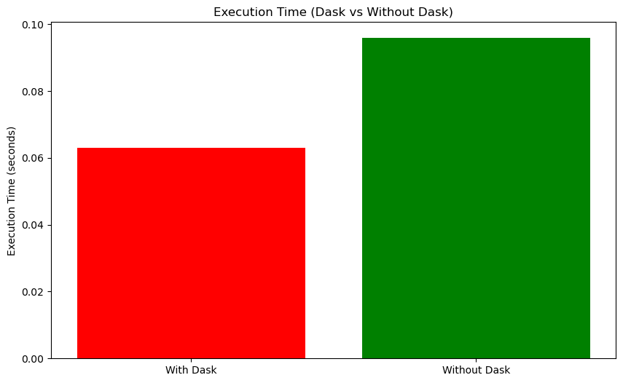
Time Plot Comparison with and without Dask
Interpretation: The bar plot illustrates the execution time comparison between using Dask and without Dask for parallelization.
The execution time was significantly reduced when using Dask (0.0631 seconds) compared to without Dask (0.0959 seconds), highlighting the efficiency gains achieved through parallel computing, making Dask a valuable tool for optimizing execution speed without compromising model performance.

Slide 18
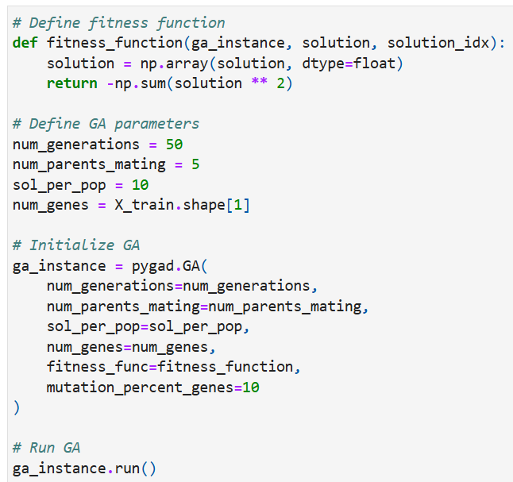
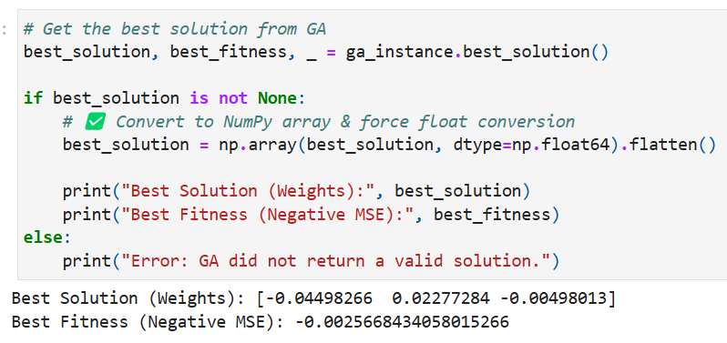
Genetic Algorithm
Interpretation: The Genetic Algorithm (GA) optimized the feature weights as [-0.04498, 0.02277, -0.00498], where negative values indicate inverse relationships and positive values indicate direct relationships with the target variable. The best fitness value of -0.00256684, corresponding to an MSE of approximately 0.00257, suggests that the model has low prediction error and good performance in minimizing squared errors.

Slide 19
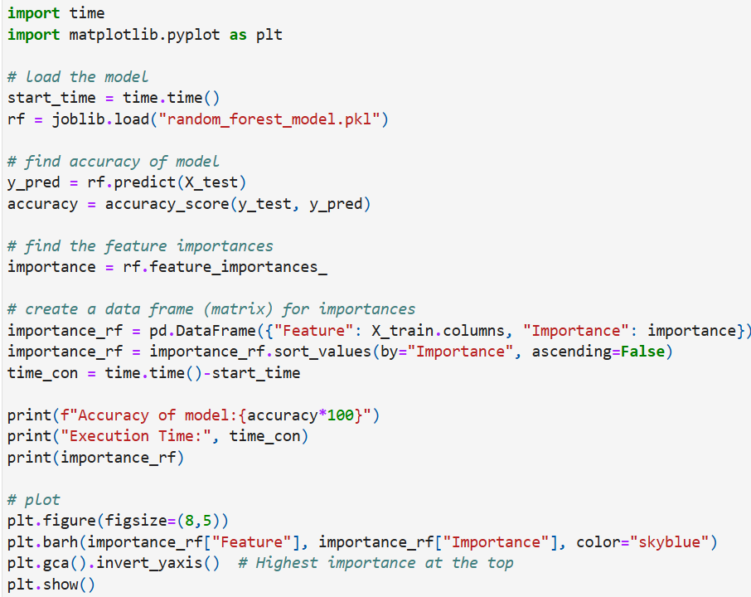
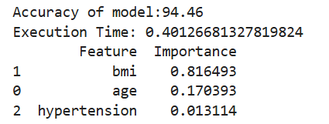
Genetic Algorithm
Interpretation: The Random Forest model achieved 94.46% accuracy, demonstrating strong predictive performance, with an execution time of 0.40 seconds, indicating efficient processing. Among the features, BMI (81.65%) had the highest influence, followed by Age (17.04%), while Hypertension (1.31%) had minimal impact. This suggests that BMI is the primary determinant in the model's predictions, with age playing a secondary role, whereas hypertension contributes negligibly.

Slide 20
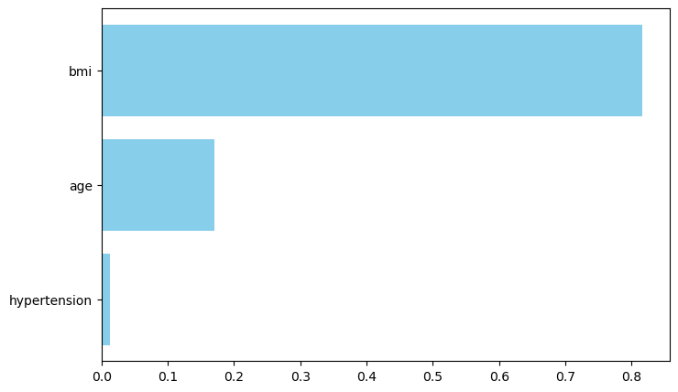
Genetic Algorithm
Interpretation: The bar chart represents the feature importance of a Random Forest model in predicting heart disease. The BMI feature has the highest importance (approximately 0.82), suggesting it has the strongest influence on predictions. Age follows with a moderate impact (~0.17), while hypertension contributes the least (~0.013), indicating minimal predictive power. This aligns with the model's accuracy of 94.46%, confirming that BMI is the most crucial predictor in this dataset.

Slide 21
Research Question for Grouping and Aggregation
How does the combination of high BMI and smoking affect hypertension likelihood?

Slide 22
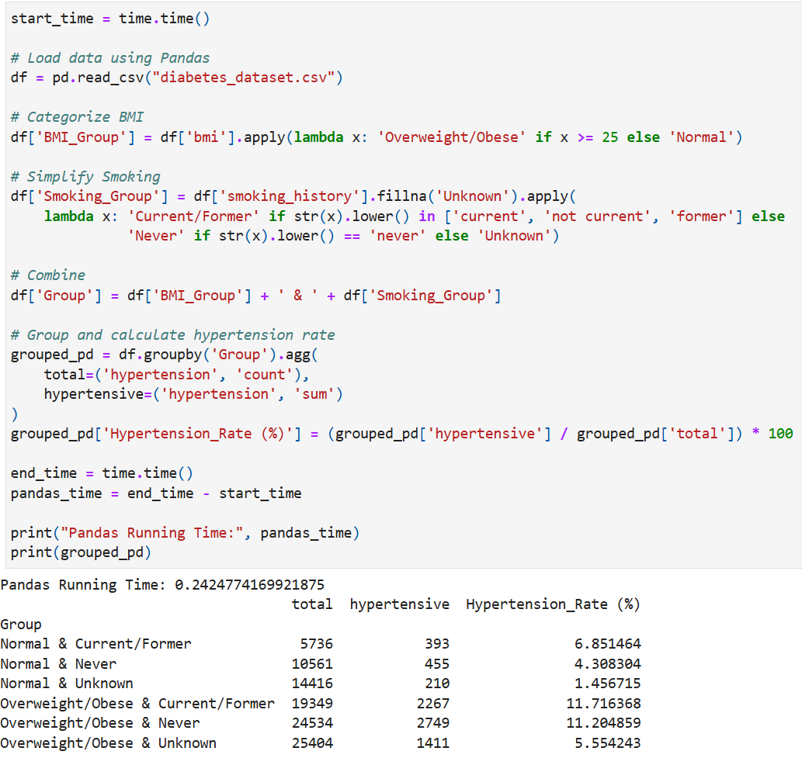
Grouping and Aggregation with Pandas
Interpretation: The analysis shows that individuals who are overweight or obese and have a current or former smoking history have the highest hypertension rate at 11.72%, indicating a compounded health risk when both factors are present. Conversely, those with a normal BMI and no smoking history show the lowest rate at 4.31%, while the group with unknown smoking history and normal BMI has the lowest overall rate (1.46%), likely due to data ambiguity or underreporting. These results suggest that both higher BMI and smoking are significant contributors to hypertension risk, and their combination further elevates that risk. The computation was completed using Pandas in approximately 0.24 seconds, demonstrating efficient processing for the dataset size.

Slide 23
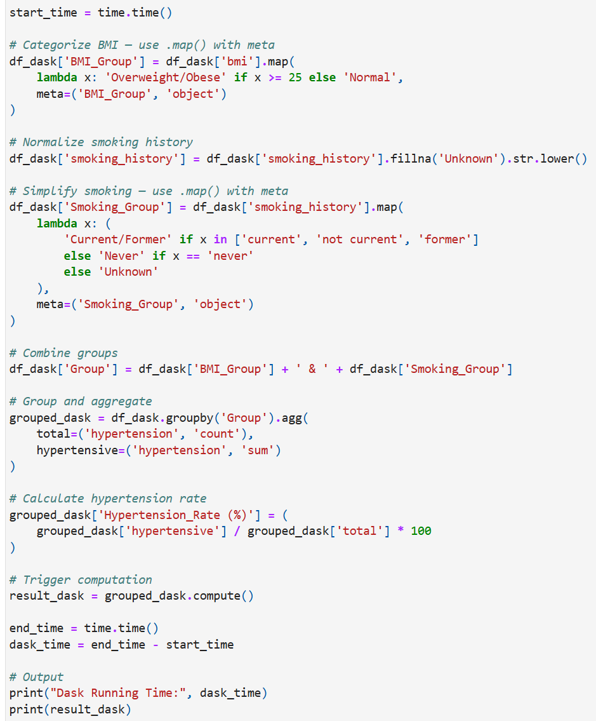
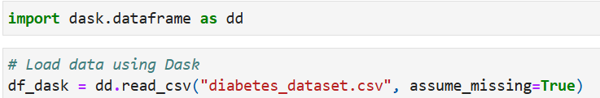
Grouping and Aggregation with Dask

Slide 24
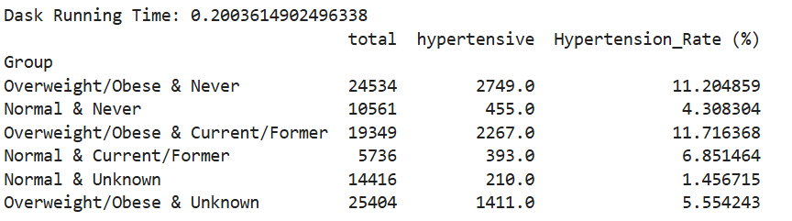
Grouping and Aggregation with Dask
Interpretation: The Dask-based computation produced the same hypertension rate results as Pandas, confirming consistency in analytical outcomes across both tools. However, the key difference lies in execution time, Dask completed the task in approximately 0.20 seconds, slightly faster than Pandas 0.24 seconds. This highlights Dask’s ability to perform efficient computations, especially beneficial when working with larger or more complex datasets, while still maintaining the same level of accuracy.

Slide 25
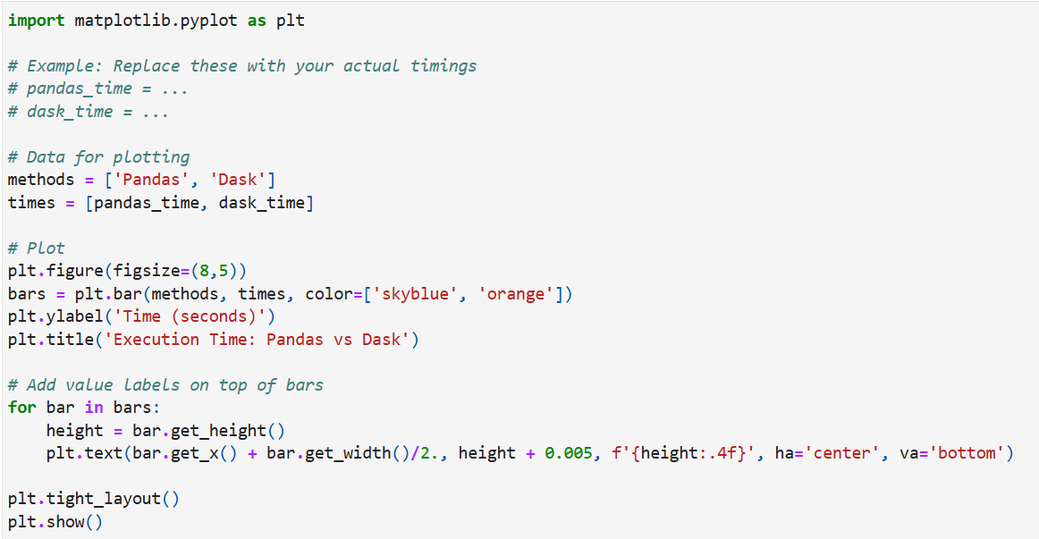
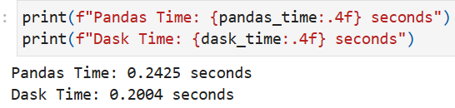
Time Plot Comparison: Pandas Vs Dask

Slide 26
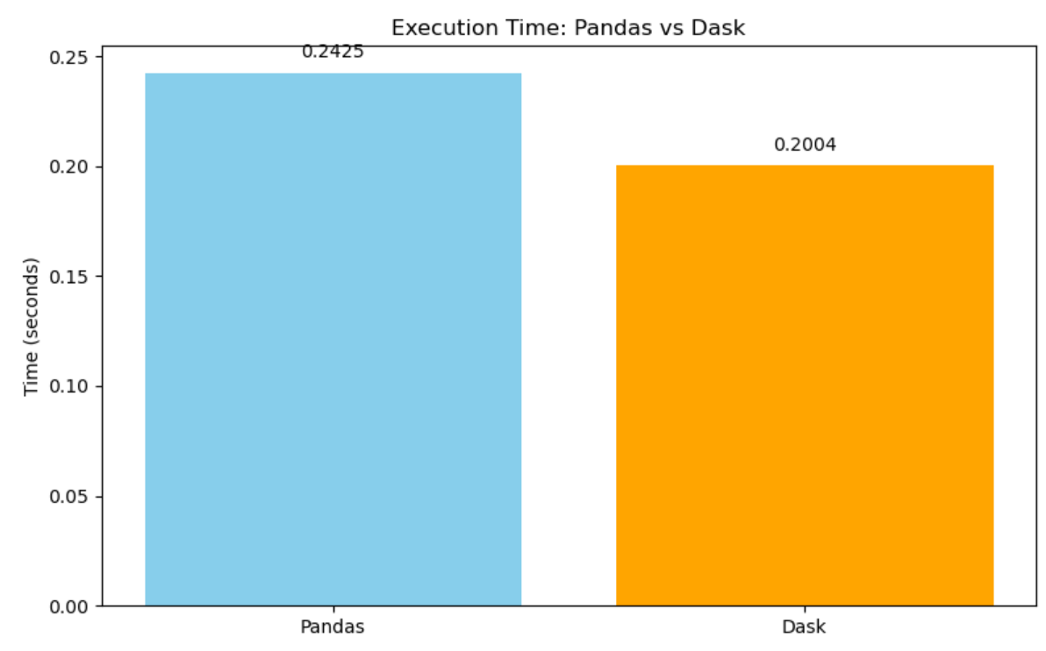
Time Plot Comparison: Pandas Vs Dask
Interpretation: This bar chart compares the execution times of Pandas and Dask when analyzing hypertension rates by BMI and smoking status. Both tools produced identical analytical results, but Dask executed slightly faster (0.2004 seconds) compared to Pandas (0.2425 seconds). The visualization highlights Dask's performance advantage, especially useful for larger datasets, while maintaining consistent accuracy with Pandas.

Slide 27
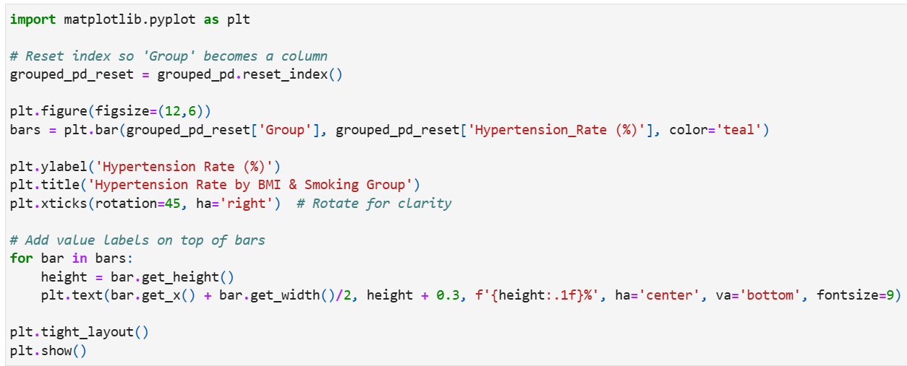
Pandas Visualization

Slide 28
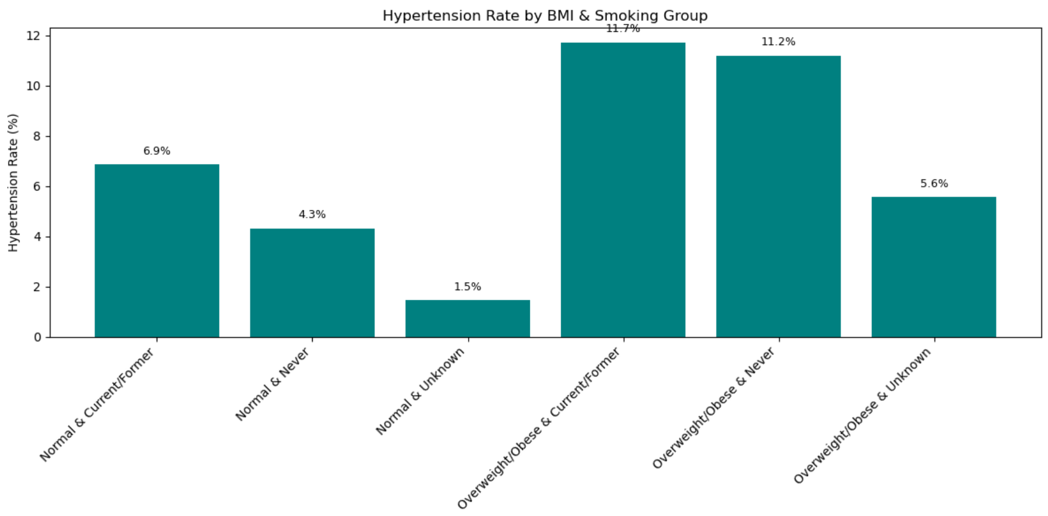
Interpretation: This bar chart illustrates the hypertension rate (%) across different combinations of BMI and smoking status. The highest hypertension rate (11.7%) is observed among individuals who are overweight or obese and have a current or former smoking history, indicating a compounded risk due to both factors. In contrast, those with a normal BMI and no smoking history show a significantly lower rate (4.3%), suggesting a protective effect of healthier lifestyle habits. Groups with "Unknown" smoking history tend to have lower rates, likely due to data gaps or misclassification. Overall, the chart visually reinforces the correlation between lifestyle risk factors like obesity and smoking and increased hypertension prevalence.

Slide 29
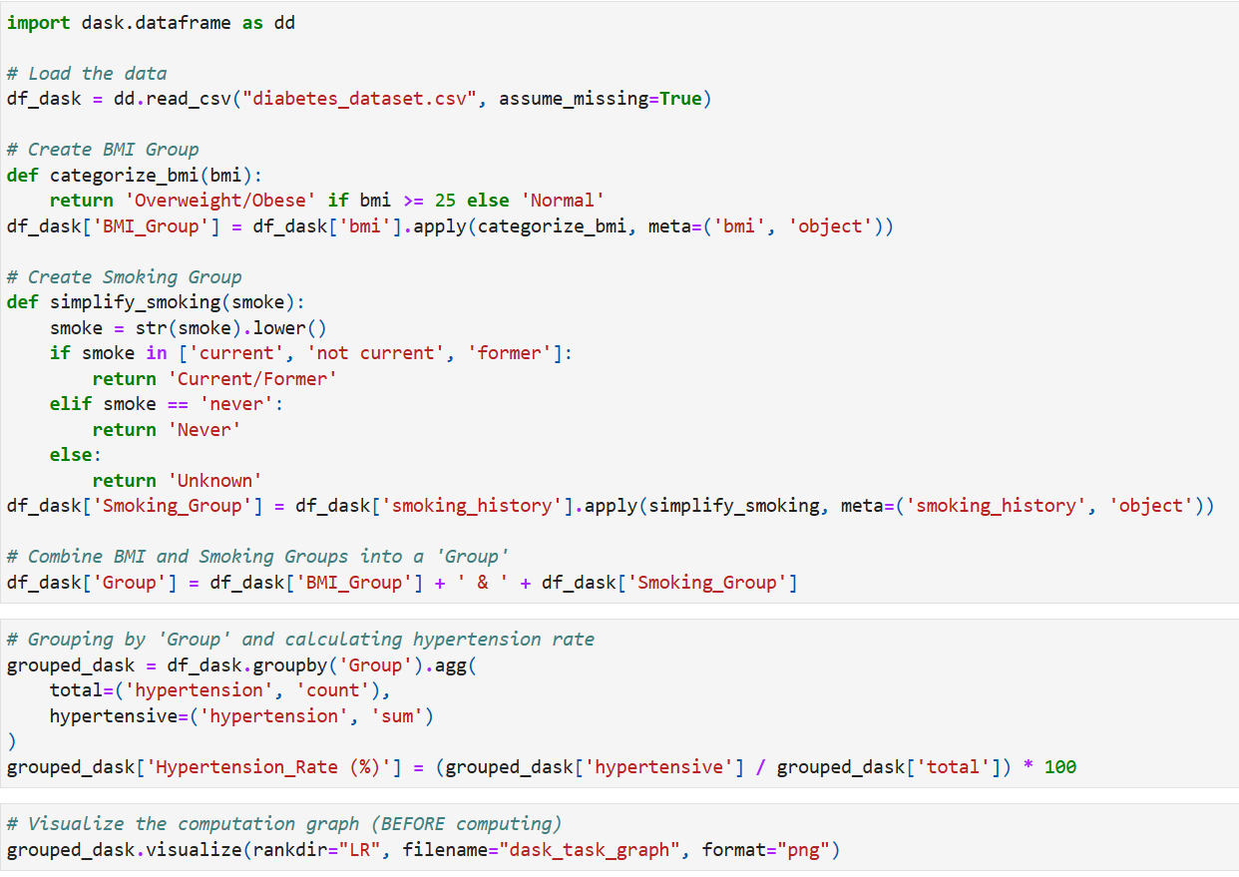
Dask Visualization

Slide 30
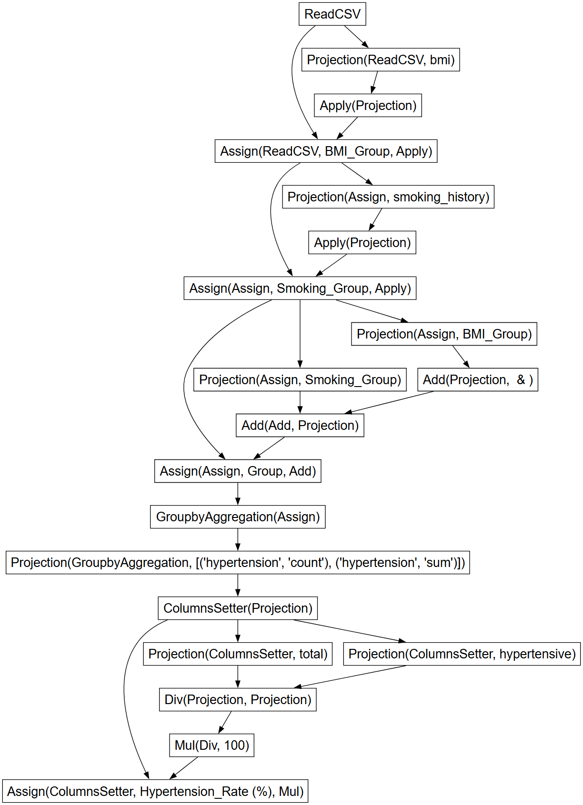
Interpretation: The Dask task graph generated by grouped_dask.visualize() illustrates the end-to-end parallel execution plan for calculating hypertension rates. It begins with reading partitioned Parquet files, followed by applying custom functions to compute BMI and categorize smoking status using map_partitions. The data is then grouped likely by BMI and smoking categories using a groupby, which triggers a shuffle operation to align similar keys across partitions. Aggregation tasks then compute group-level statistics, after which the hypertension rate is calculated by dividing hypertension cases by total counts. The graph clearly shows how Dask parallelizes these steps, with multiple tasks running concurrently, and highlights dependencies between them, offering insight into performance and potential bottlenecks.

Slide 31
Conclusion
To conclude our project combined machine learning and high-performance computing to predict heart disease risk accurately and efficiently.
We identified hypertension, obesity, smoking, and age as crucial predictors for early detection of heart disease risk.
Optimizing data loading with fread improved logistic regression execution time from 1.17s to 1.09s before profiling and from 1.73s to 1.43s after profiling, without affecting model significance (p-values < 0.0001).
Using Dask for parallel computing reduced model execution time from 0.0959s to 0.0631s, while maintaining ~94% accuracy, demonstrating significant computational efficiency.
Feature selection using Random Forest achieved 94.46% accuracy, with BMI contributing 81.65% importance, age 17.04%, and hypertension 1.31%.
Hypertension analysis showed that Dask completed the task faster (0.2004s) compared to Pandas (0.2425s), revealing the highest hypertension rate (11.72%) in overweight/obese smokers and the lowest rate (4.31%) in individuals with normal BMI and no smoking history.
Thus, High-performance computing tools like Dask and fread enhanced scalability, speed, and practicality, making large-scale heart disease prediction more accessible for real-world healthcare datasets.

Slide 32
References
Rehman, M. U., Naseem, S., Butt, A. U. R., Mahmood, T., Khan, A. R., Khan, I., Khan, J., & Jung, Y. (2025). Predicting coronary heart disease with advanced machine learning classifiers for improved cardiovascular risk assessment. Scientific Reports, 15(1). https://doi.org/10.1038/s41598-025-96437-1
García-Ordás, M. T., Bayón-Gutiérrez, M., Benavides, C., Aveleira-Mata, J., & Benítez-Andrades, J. A. (2023). Heart disease risk prediction using deep learning techniques with feature augmentation. Multimedia Tools and Applications, 82(20), 31759–31773. https://doi.org/10.1007/s11042-023-14817-z
Pal, M., & Parija, S. (2021). Prediction of Heart Diseases using Random Forest. Journal of Physics Conference Series, 1817(1), 012009. https://doi.org/10.1088/1742-6596/1817/1/012009

Slide 33
Contributions
Revathi Surisetty – Project 1
Shreya Podipireddy – Project 2
Nitin Varma Gokaraju – Project 3
Fnu Arshika Farzeen – Project 4
Sravani Pendyala – Project 5

Slide 34
Thank you

